Slide 1
MODULE : 1

Slide 2
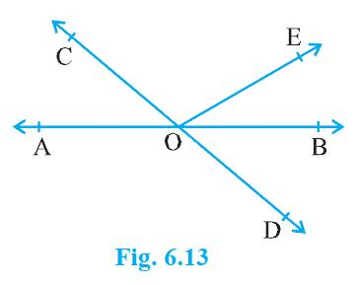
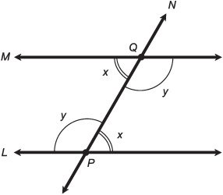
Lines and Angles
A
B
∠A + ∠B + ∠C = 180º
C

Slide 3
PAIRS OF ANGLES
VERTICALLY OPPOSITE ANGLES
A
D
O
C
B
Note : Vertically Opposite angles are EQUAL
∠AOC and ∠BOD,
∠AOD and ∠COB
∠AOC = ∠BOD,
∠AOD = ∠COB
form pairs of vertically opposite angles.

Slide 4
MODULE : 2

Slide 5
Adjacent Angles
Two angles are said to be adjacent
A
B
angles if
They have common vertex.
They have common ray.
Non-common arms should lie on
either side of common arm.
D
C
∠ADB,
∠BDC
D
D
Have common vertex ‘D’.
Have common arm ray BD.
ray AD and ray DC are non common arm lying on either side of common arm BD

Slide 6
Adjacent Angles
Two angles are said to be adjacent
angles if
S
They have common vertex.
P
They have common ray.
Non-common arms should lie on
either side of common arm.
Q
R
Consider ∠PQR and
∠SQR
Q
Q
Have common vertex Q.
QR is the common ray.
Non-common arms QS and QP lie on the
same side of common arm QR
∠PQR and ∠SQR are not adjacent angles.

Slide 7
MODULE : 3

Slide 8
PAIRS OF ANGLES
LINEAR PAIR ANGLES
Two adjacent angles are said to form a linear pair angle,
If their non-common rays
form a pair of opposite rays.
A
∠AOB and ∠BOC are the angles in a linear pair.
B
A
O
C

Slide 9
PAIRS OF ANGLES
LINEAR PAIR ANGLES
The sum of the measure of a linear pair angle is 180°
B
∠AOB + ∠BOC
=
180°
A
O
C

Slide 10
MODULE : 4

Slide 11
Linear Pair Axiom
If a ray stands on a line, then the sum of the two adjacent
angles so formed is 180⁰ and vice–versa.
C
1.
If, OC stands on line AB
then,
∠AOC
+
∠COB
= 180⁰
2.
If
m∠AOC + m∠COB = 180⁰
A
O
B
then,
AB is a line and OC stands on the line.
∠AOC
+
∠COB
= 180⁰
i.e. A , O , B are collinear

Slide 12
Lines which are parallel to a given line are parallel to each other.
If
AB ⎜⎜ CD
AB ⎢⎢ CD
PQ ⎢⎢ CD
and
PQ ⎜⎜ CD
A
B
then
AB ⎜⎜ PQ
C
D
P
Q

Slide 13
MODULE : 5

Slide 14
Ex . : 6.1 - 1
In figure, lines AB and CD intersect at O. If
∠
∠
BOE
and
AOC
+
=
70º
∠
BOD
find
=
40º,
∠
BOE
C
E
and reflex
∠
COE
Sol:
∠AOC
+ ∠BOE
= 70⁰
40º
30º
∴
∠BOE
= 70⁰
– ∠AOC
….(1)
O
A
O
40º
B
But,
∠AOC = ∠BOD
[Vertically opposite angles]
∵
[ ∠BOD = 40⁰ ]
∴
∠
AOC
=
40⁰
….(2)
D
∴
∠
BOE
=
70⁰
– 40⁰
]
[ From (1) and (2)
∴
∠
BOE
=
30⁰
….(3)
?
Reflex of ∠COE = 360
– ∠COE
∴
∠
COE
+
∠
BOE
+
∠
BOD
=
180⁰
∴
∠
COE
+
30⁰
+
40⁰
=
180⁰
∴
∠
COE
=
180⁰
–
40⁰
–
30⁰
∴
∠
COE
=
110⁰

Slide 15
Ex . : 6.1 - 1
In figure, lines AB and CD intersect at O. If
∠
∠
BOE
and
AOC
+
=
70º
∠
BOD
find
=
40º,
∠
BOE
and reflex
∠
COE
C
E
Sol:
∴
∠
COE
=
110⁰
40º
30º
Reflex
∠
COE
=
360º – 110–
A
O
40º
B
∴
Reflex
∠
COE
=
250º
D

Slide 16
Thank You

